Slide 1
COVID-19 : Laboratory Surveillance
Dr. Ashok M
Scientist-B & Officer In-charge
ICMR-NIV Bangalore Unit

Slide 2
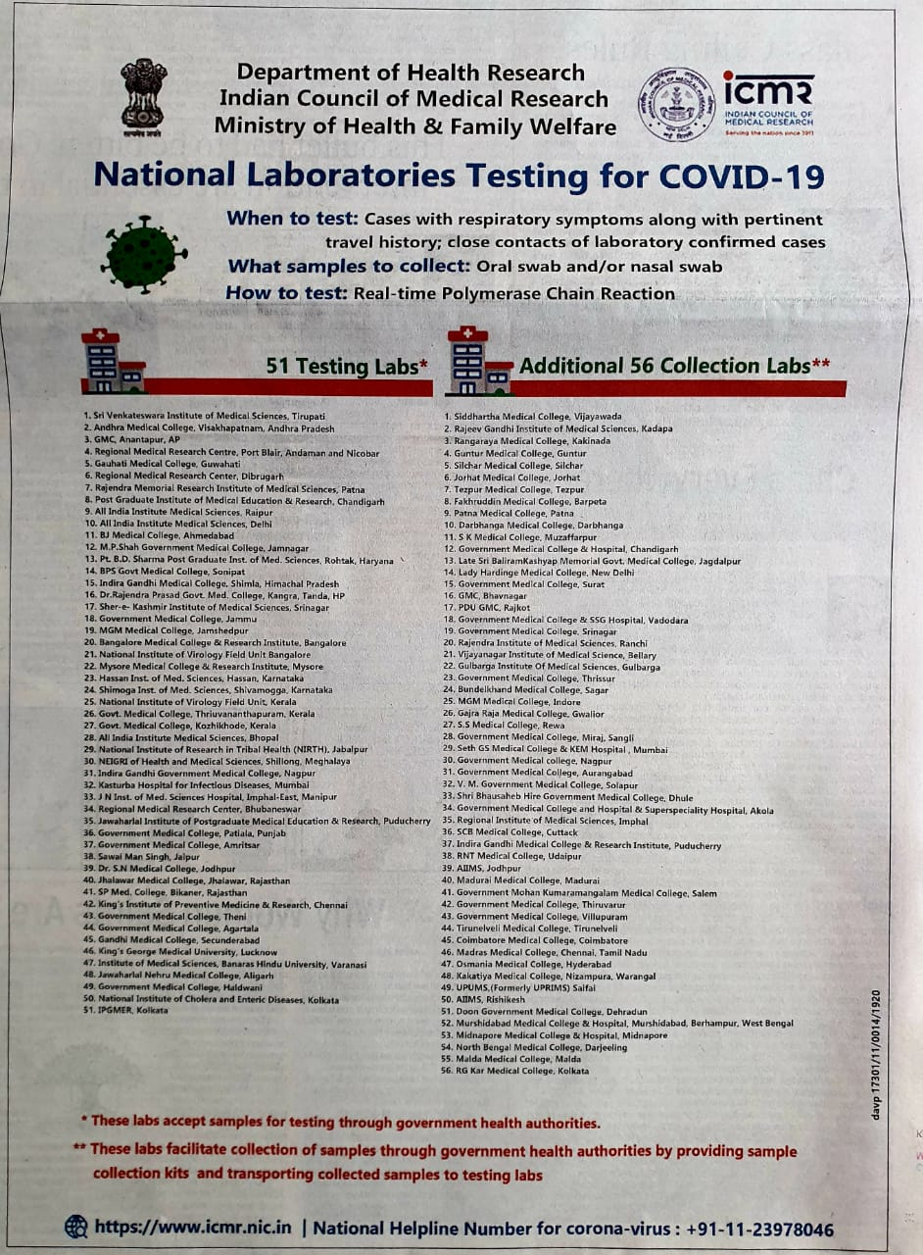

Slide 3
Topics to be covered
Sample
Collection
Packing
Transport
Laboratory testing

Slide 4
Specimen Priority
Collection of three specimen types as per recommendation
lower respiratory
upper respiratory and
serum specimens
Respiratory Specimen
Lower respiratory tract
Bronchoalveolar lavage, tracheal aspirate
Collect 2-3 mL into a sterile, leak-proof, screw-cap sputum collection cup or sterile dry container.
Sputum
Have the patient rinse the mouth with water and then expectorate deep cough sputum directly into a sterile, leak-proof, screw-cap sputum collection cup or sterile dry container.

Slide 5
Respiratory Specimen
Upper respiratory tract
Nasopharyngeal swab AND oropharyngeal swab (NP/OP swab)
Use only synthetic fiber swabs with plastic shafts.
Place swabs immediately into sterile tubes containing 2-3 ml of viral transport media.
NP and OP specimens should be kept in separate vials.
Nasopharyngeal wash/aspirate or nasal aspirate
Collect 2-3 mL into a sterile, leak-proof, screw-cap sputum collection cup or sterile dry container.
Serum
Blood
Children and adults: Collect 1 tube (5mL) of whole blood in a serum separator tube.
Infant: A minimum of 1 mL of whole blood is needed for testing peadiatric patients. If possible, collect 1 mL in a serum separator tube.

Slide 6
Storage
Store specimens at 2-8°C and ship overnight to diagnosis laboratory on ice pack.
LRF and specimen label
Completely filled LRF
Travel history – name of country travel with period
Time period of travel and onset of symptoms
Contact history with positive cases
Specimen label
Patient ID

Slide 7
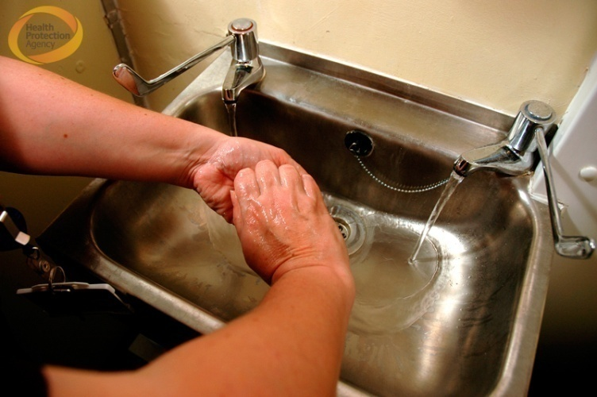
Personnel Protective Equipment (PPE)

Slide 8
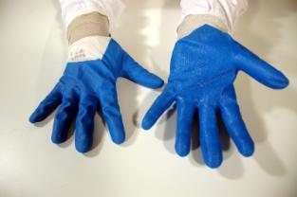
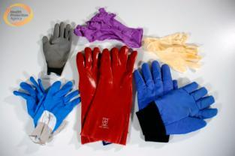
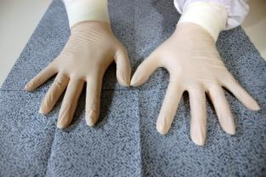
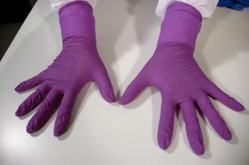
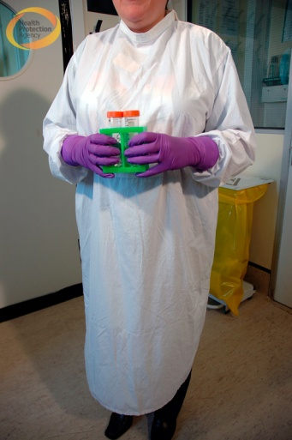
Personnel Protective Equipment (PPE)
Cuts and abrasions should be covered prior to entry to the ward/laboratory
Gloves should be:
Suitable for the procedure –
Chemically compatible
Changed regularly when working with hazardous agents
Gowns and Coverall suits:
Disposable gowns should be worn
Should be fastened correctly
Should have close fitting cuffs
Should be single use

Slide 9
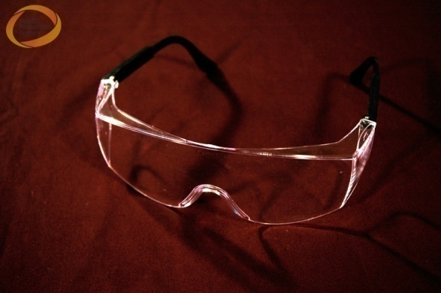
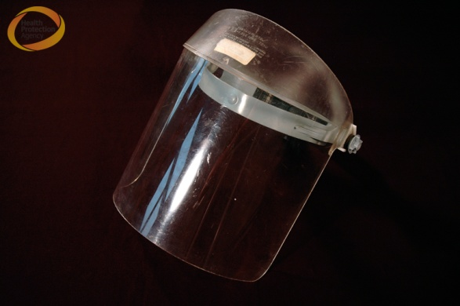
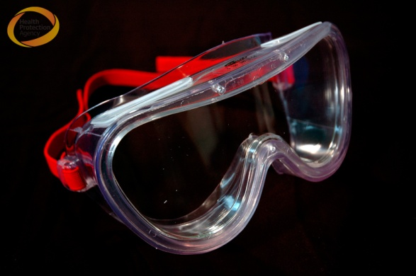
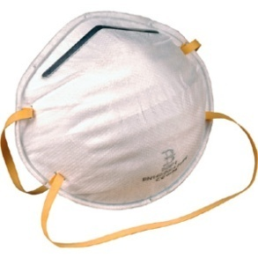
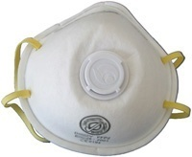
Personnel Protective Equipment (PPE)
Mucosal membranes (eyes)
Safety glasses
Goggles
Full face visor
Face masks
N95 respirator is the most common of particulate filtering face piece respirators.
This product filters at least 95% of airborne particles

Slide 10
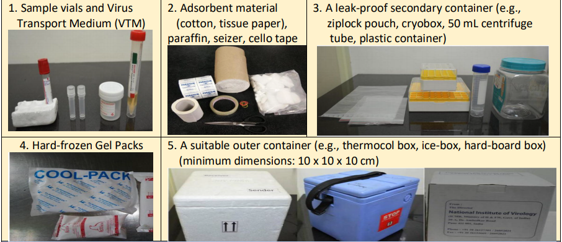
Specimen collection & Transportation

Slide 11
Specimen collection & Transportation

Slide 12
Specimen collection & Transportation

Slide 13
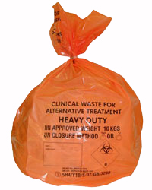
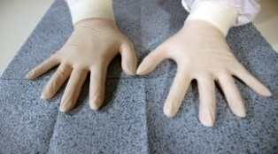
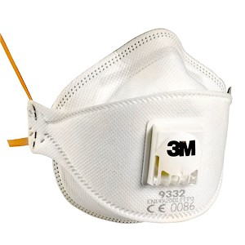
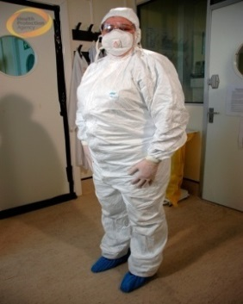
Personnel Protective Equipment (PPE)
PPE Disposal
Autoclave or incinerate

Slide 14
Corona virus

Slide 15
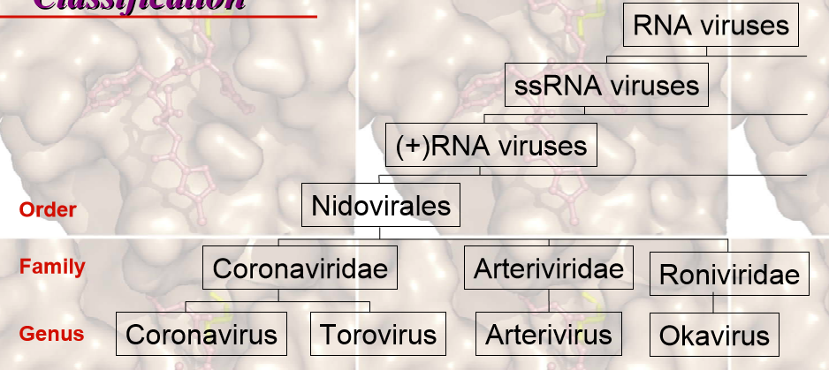
Classification

Slide 16
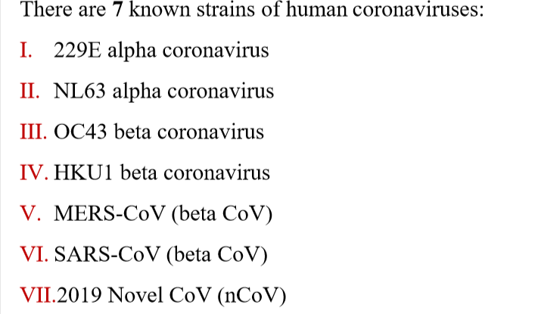
Corono virus infecting Humans

Slide 17
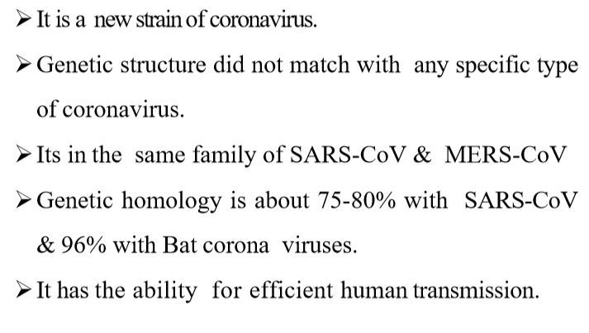
COVID-19

Slide 18
COVID-19 - Structure
Envelope (E) protein-Smallest of the major structural proteins, but most enigmatic, 76–109 amino acids.
Glycopeptide Spike (S),
Membrane (M)-Most abundant structural protein
Nucleocapsid (N) proteins
Enzyme - RNA dependent RNA polymerase

Slide 19
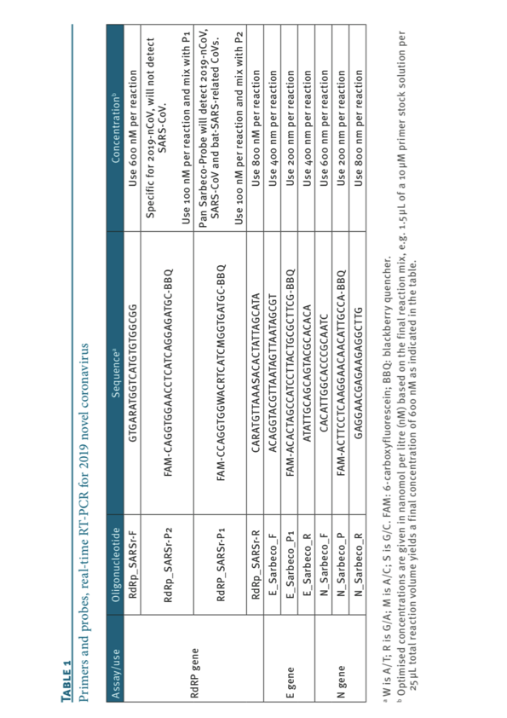
COVID-19 –PCR primer/probes
Suspected human sample should be first tested for E gene assay
Confirmatory assay by RdRp and N & ORF gene assay

Slide 20
Thank you

