Slide 1
STRENGTHENING COMMUNITY SURVEILLANCE FOR COVID-19
Integrated Disease Surveillance Programme
National Centre for Disease Control
Directorate General of Health Services
Ministry of Health and Family Welfare, Govt. of India
Dr Lokesh Alahari
Sub Regional Team Leader – Karnataka
WHO – India NPSP
(9 March 2020)

Slide 2
Epidemiology of COVID-19
Agent - Corona viruses belong to a large family of viruses, some causing illness in people and others that circulate among animals, including camels, cats, bats etc.
The etiologic agent responsible for present outbreak of COVID-19 is SARS-CoV-2 which is a novel coronavirus.
Transmission of coronaviruses can occur via respiratory secretions. Nosocomial transmission has been documented in COVID-19.
Current estimates of the incubation period of 2019-nCoV range from 2-14 days.
Most common symptoms include fever, fatigue, dry cough and breathing difficulty. Upper respiratory tract symptoms like sore throat, rhinorrhea, and gastrointestinal symptoms like diarrhea and nausea/ vomiting are seen in about 20% of cases.

Slide 3
Case definitions – Suspect case
A patient with acute respiratory illness {fever and at least one sign/symptom of respiratory disease (e.g., cough, shortness of breath)}, AND a history of travel to or residence in a country/area or territory reporting local transmission (See NCDC website for updated list) of COVID-19 disease during the 14 days prior to symptom onset;
OR
A patient/Health care worker with any acute respiratory illness AND having been in contact with a confirmed COVID-19 case in the last 14 days prior to onset of symptoms;
OR
A patient with severe acute respiratory infection {fever and at least one sign/symptom of respiratory disease (e.g., cough, shortness breath)} AND requiring hospitalization AND with no other etiology that fully explains the clinical presentation;
OR
A case for whom testing for COVID-19 is inconclusive.

Slide 4
Case definitions – Laboratory confirmed case
A person with laboratory confirmation of COVID-19 infection, irrespective of clinical signs and symptoms.

Slide 5
Definition of Contact
A contact is a person that is involved in any of the following:
Providing direct care without proper personal protective equipment (PPE) for COVID-19 patients
Staying in the same close environment of a COVID-19 patient (including workplace, classroom, household, gatherings).
Traveling together in close proximity (1 m) with a symptomatic person who later tested positive for COVID-19.

Slide 6
Types of contacts
High Risk
Low Risk
Touched body fluids of the patient (Respiratory tract secretions, blood, vomit, saliva, urine, faeces)
Had direct physical contact with the body of the patient including physical examination without PPE.
Touched or cleaned the linens, clothes, or dishes of the patient.
Lives in the same household as the patient.
Anyone in close proximity (within 3 ft) of the confirmed case without precautions.
Passenger in close proximity (within 3 ft) of a conveyance with a symptomatic person who later tested positive for COVID-19 for more than 6 hours.
Shared the same space (Same class for school/worked in same room/similar and not having a high risk exposure to confirmed or suspect case of COVID-19).
Travelled in same environment (bus/train/flight/any mode of transit) but not having a high-risk exposure.

Slide 7
Key considerations – Surveillance
Surveillance period is for 28 days – (14 days quarantine at home or hospital or a designated facility and next 14 days is for self reporting)
Testing –
All high risk contacts to be tracked, quarantined and lab-tested as per the protocol.
For low risk contacts – lab-test only when the person under surveillance develops symptoms.
Sample – Throat swab, Nasopharyngeal swab (Details in the session on lab)
Treatment :
Symptomatic Management
No drug(s) or vaccine recommended presently

Slide 8
Key considerations – Surveillance (Contd.)
Indian Nationals – Irrespective of the location of the health care facility where the suspect/confirmed case is admitted, it will be included in the line list of the State where the case resided during the last 14 days (prior to or after the onset of the symptoms)
In case of any conflict, the States may discuss the matter amongst themselves and take a decision
Foreign Nationals - An individual or a group of foreign nationals if found positive and admitted in a designated health facility in a particular State, that state to include such foreigners in its line list.

Slide 9
Key consideration – Contact Tracing
A positive case may have contacts in multiple Districts/ States
Tracking of all the contacts located in a particular District/State will be the responsibility of that District/State
In case of any high risk contact found in the particular District/State, sampling to be carried out by District/State along with Home/Hospital quarantine of the said contact.
Sampling to be carried out strictly in accordance with the guidelines
Symptomatic Suspects and High Risk Contacts

Slide 10
Screening of Travelers for 2019-nCoV
In flight announcement
Filling of Self declaration form
Suspect case – Case Definition
Will be referred to designated Hospital and information shared with CSU IDSP/NCDC
Close contacts (co passengers seated in the same row, 3 rows in front and 3 rows behind along with some of the cabin crew) – Information be shared as per interim guidelines
List of passengers who have history of close contact (as per self declaration form) will be shared to IH Division and State/District for in-country surveillance by IDSP on daily basis.

Slide 11
Home Quaratine/Isolation
Every Passenger arriving in India from COVID-19 affected countries to be followed up for 28 days irrespective of symptoms
Follow up by concerned PHC Staff and reporting to Taluka
Taluka to compile, follow-up every day and share with District Surveillance unit
District to prepare line-list and update every day to State Surveillance Unit
Daily personal visit follow-up / telephonic
Always keep personal details of persons confidential- Both symptomatic and asymptomatic
ABC- Aged/Sex, Taluka, District, ……… National, returned from………. Country……. Days back.

Slide 12
Advice to persons who are on home quarantine
Be informed of illness
Stay home, preferable isolate yourself in a separate well ventilated room, avoid common areas frequented by other member of family
Avoid frequent contact with other. If inevitable always maintain at least 2 metres distance
Avoid frequent touching of face; Avoid hand shaking and wash hands frequently with soap and water
Follow Cough Etiquette
Take plenty of fluids
Avoid having visitors
Wash linen separately and clean surfaces with detergent or 0.5% hypochlorite solution (available)
Monitor your health for appearance of symptoms like fever, cough and/or breathing difficulty. If you develop any of these symptoms please contact nearest health facility, DSO or 104 health helpline for further guidance

Slide 13
Contact Tracing
Identify contacts of the infected patient and record:
Names, contact, demographic information.
Date of first and last exposure or date of contact with the confirmed or probable case, and.
Date of onset when fever or respiratory symptoms develop.
The common exposures and type of contact with confirmed or suspected cases should be thoroughly documented for any contacts that become infected.

Slide 14
Safety precautions for contact tracing for Health Staff
Maintain - 2 meter from the contact
Masks should be worn by the contact tracing team
Personal protective equipment (PPE) as per requirements
Maintain IPC and hand washing

Slide 15
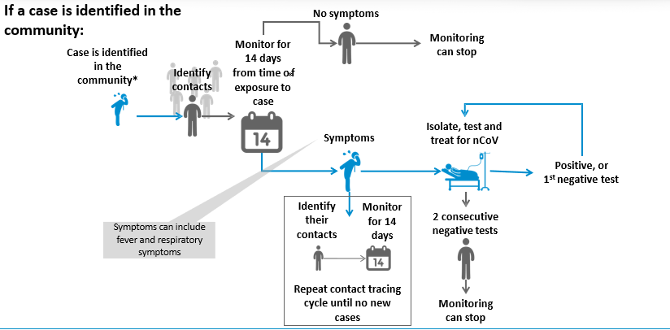

Slide 16
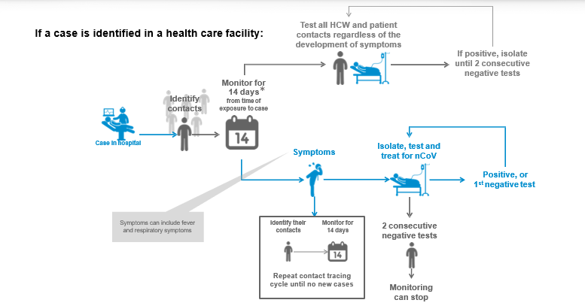
Directorate of Health and Family Welfare Services (DH&FWS), Anand Rao Circle, Bangalore

Slide 17
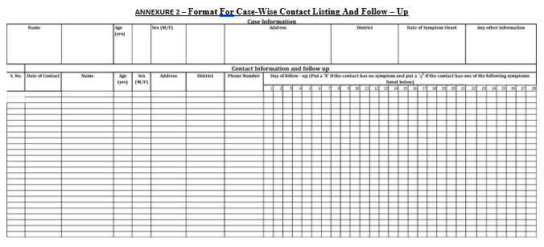

Slide 18
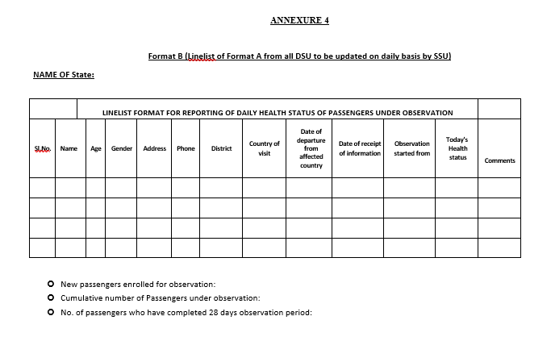

Slide 19
Lab Testing Facilities - Karnataka
NIV Pune is the reference laboratory in India for testing COVID-19
NIV Pune received positive controls from Berlin, Germany.
In Karnataka:
NIV Benglauru Unit - Bengaluru.
VRDL BMC& RI - Bengaluru.
To be operational this week:
MMC- Mysuru
HIMS- Hassan
SIMS- Shivamogga

Slide 20
Cluster containment Strategy
Scenarios:
Travel related cases reported in India
Local transmission of COVID-19 (Single Cluster)
Large outbreaks of COVID-19 disease (Multiple cluster)
India becomes endemic for COVID-19
IDSP, will be involved in community surveillance in all of the above mentioned scenarios.

Slide 21
Containment zone
A Central RRT will help the State/ District administration in mapping the Containment Zone.
The containment zone will be defined based on
The index case / cluster, which will be the designated epicenter.
Geographical distribution of cases around the epicenter.
Local administrative boundaries of urban cities /town
A scenario based approach (e.g. a small cluster in a closed environment or single cluster in a residential colony) while deciding the perimeter of containment zone.
The decision on perimeter of the containment zone is to be guided by continuous real time risk assessment.

Slide 22
Containment zone Cont…
Implementation of strict perimeter control is vital for the containment of COVD-19.
Perimeter control is primarily an administrative measure – Enhanced surveillance within the perimeter is a part of the larger administrative response.
Rapid Response Teams (RRTs) needs to be oriented on the enhanced surveillance & contact tracing.

Slide 23
Buffer Zone
Buffer Zone is an area around the Containment Zone, where new cases most likely to appear.
There will not be any perimeter control for the buffer zone.
Containment Zone
Buffer Zone

Slide 24
Surveillance Activities in Containment Zone

Slide 25
Surveillance Activities in Containment Zone
The residential areas will be divided into sectors for the ASHAs/Anganwadi Workers/ANMs each covering 50 households (30 households in difficult areas).
Supervisory officers (PHC/CHC doctors) in the ratio of 1:4.
The field workers (FW) will be performing active house to house surveillance daily in the containment zone from 8:00 AM to 2:00 PM and also encourage self reporting.
Line list the family members, contact listing, identification of close contacts and all those having symptoms.
The field worker will provide a mask to the suspect case and to the care giver identified by the family.
The suspect will be isolated till such time he/she is examined by the supervisory officer.
Follow up contacts identified by the RRTs within the sector allocated to the FWs.
As per case definition the supervisory officer, visit house, make arrangements to shift the suspect case to the designated treatment facility.
The supervisory officer will collect data from the health workers under him/ her, collate and provide the daily and cumulative data to the control room by 4.00 P.M. daily.

Slide 26
Scenario 1: Imported Travel related cases reported in India
Containment Zone
Buffer Zone
Isolation & management of case
Quarantine of contacts
Enhanced IEC
Active ARI/ILI Surveillance
Enhanced self reporting
Enhanced personal hygiene, hand hygiene & cough etiquettes
Enhanced Passive ARI/ILI Surveillance
Enhanced Self reporting

Slide 27
Scenario 2: Local transmission – Single cluster
Containment zone
Buffer zone
Isolation & management of case
Quarantine of contacts
Enhanced IEC
Active ARI/ILI Surveillance
Enhanced self reporting
Enhanced personal hygiene, hand hygiene & cough etiquettes
Establish control room in the local health facility
Ban local mass gathering
Lockdown of identified cluster for e.g. Schools/residential building/Hotel
Enhanced Passive ARI/ILI Surveillance
Enhanced Self reporting.
Enhanced media surveillance
Trainings on case definitions and contacts

Slide 28
Scenario 3: Large outbreak – Multiple clusters
Containment zone
Isolation & management of case
Quarantine of contacts
Enhanced IEC
Active ARI/ILI Surveillance
Enhanced self reporting
Enhanced personal hygiene, hand hygiene & cough etiquettes
Ban local mass gathering
Closure of schools, offices, colleges
Environment disinfection
Refrain from leaving home + Border measures
Establishment of control room at the block and district level
Enhanced media surveillance in and surrounding blocks/districts
Monitoring of rumour register
Mobile specimen collection units

Slide 29
Scenario 3: Large outbreak – Multiple clusters
Buffer zone
Isolation & management of case
Quarantine of contacts
Enhanced IEC
Active ARI/ILI Surveillance
Enhanced self reporting
Enhanced personal hygiene, hand hygiene & cough etiquettes
Border measures
Ban all mass gatherings in buffer zone
Media surveillance
Mobile specimen collection units

Slide 30
Scenario 4: Becomes Endemic
Isolation & management of cases as per guidelines
Enhanced IEC
Routine Lab ARI/ILI Surveillance
Enhanced self reporting
Enhanced personal hygiene, hand hygiene & cough etiquettes
Categorisation & Treatment
Other Lab tests/Serological tests as per availability
Research
Vaccination as per availability
Media scanning and verification
Rumour register monitoring

Slide 31
Containment Perimeter- Border measures
Refrain from leaving their homes and moving around from the containment zone for at least 14 days
Refrain participating in events held in indoor venues when fever or respiratory symptoms are detected.
Employers to cooperate for leaves or absence without a written diagnosis
Enhanced entry screening for travellers from containment zone
Involvement of all concerned departments.

Slide 32
IEC/BCC activities
Education department
Women and Child Development Department
Transport Department
Food safety Department
Department of Animal Husbandry
Tourism Department
IT/BT departments
Police department
RDPR, UDD and other departments
Other stakeholders like medical associations (IMA, IAP, PHANA), nursing associations, hotel association, Clubs, NGOs, WHO, Unicef, Resident Welfare associations etc.
State Level Meetings have been held with concerned departments and state advisories also have been issued

Slide 33
Monitor Surge capacities Daily– (Human resource, Hospitals Logistics etc.)
Infection prevention & Triage facilities at Hospitals
Designation of Isolation wards at Hospitals : Monitor minimum standards and requirements
Identification of Govt./Non Governmental buildings to be designated as isolation/quarantine centres (Large, exclusive isolation facilities)
Additional workforce may be mobilized from neighbouring Districts/Medical colleges/private hospitals/NGOs/Trained Volunteers to cover household in containment zone.
Nursing students/other paramedical workers may be oriented in advance for proper mobilization of the staff during the containment procedures.
Adequate logistics to be maintained at District and Taluka levels.
Stocks of Personal protective equipment (PPE), Masks, Medicines, sample collection kits etc.

Slide 34
Monitor Surge capacities Daily
District Monitoring Committee Chaired by DC, Taluka Monitoring committee: Roles and responsibilities
District Rapid response teams: Multi-departmental with name-wise list and clear roles
Proper information to general public- all modes of communications/ meetings/media
Risk Communication
Manage rumours, legal case if required
District control room- DCs can use disaster management call centre manned by heath personnel
Points of Entry to be reviewed daily as per Government instructions: Road, Airport, Seaport

Slide 35
Monitor Surge capacities Daily
Update on 28 day follow-up of travellers
Contact tracing if applicable
Training of health staff at all levels
Review Ambulance availability and redeployment
Co-ordination with private hospitals
Availability and over-pricing of masks
Budget availability and re-allocations

Slide 36
Actions at State
Daily state media briefing by Hon’ble Minister for Health & Family Welfare / Hon'ble Medical Education Minister at 6:00 pm
Daily state review Meeting by Additional Chief Secretary-Health & Family welfare
Chief Secretary- Government of Karnataka reviewing regularly
Co-ordination meetings with individual departments and sectors and advisories/instructions given
Regular communication, instruction, advisories to districts

Slide 37
Latest Travel Advisory: GOI (6th March 2020)
Indian citizens are advised to refrain from travel to China, Iran, Republic of Korea, Italy & Japan and advised to avoid non-essential travel to other COVID-19 affected countries.
In supersession of all earlier advisories , the latest Travel Advisory mentions :
All Regular/eVisas/ issued to nationals of Italy, Iran, South Korea and Japan issued on or before March 03, 2020 and who have not yet entered India, stand suspended with immediate effect.
Regular/eVisa issued to nationals of Peoples Republic of China issued on or before February 05, 2020 were suspended earlier, which shall remain in force.
Those requiring to travel to India due to compelling reasons, may seek fresh visa from nearest Indian Embassy/Consulate.
Regular/eVisas issued to all other foreign nationals who have travelled to Peoples Republic of China, Iran, Italy, South Korea and Japan, on or after February 01, and who have not yet entered India, stand suspended with immediate effect.
All foreign and Indian nationals entering into India from any port, are required to furnish duly filled self declaration form including personal particulars and travel history to Health officials and Immigration officials at all ports.

Slide 38
Latest Travel Advisory: GOI (6th March 2020)
Compulsory Certification of having tested negative for COVID-19
In addition to Visa restrictions already in place, passengers traveling from /having visited Italy or Republic of Korea and desirous of entering India will need certificate of having tested negative for COVID-19 from the designated laboratories authorized by the health authorities of these countries. This will be enforced from 0000 Hrs of 10th March, 2020 and is a temporary measure till cases of COVID-19 subside
Universal Screening and self-declaration
All international Passengers entering into India are required to furnish duly filled self-declaration
form (including personal particulars i.e. phone no. and address in India) to Health Officials and
Immigration officials and undergo Universal Health Screening at the designated health counters
at all Points of Entry

Slide 39
Latest Travel Advisory: GOI (6th March 2020)
While returning back to India, if a traveler feels sick during his/her journey:
To Inform the airlines crew about illness.
Seek mask from the airline crew.
Follow the directions of airline crew.
Follow the direction of the airport health officer after disembarkation.
If a traveler feel sick (cough/fever or difficulty in breathing) within 28 days after return from COVID-19 affected areas:
Immediately call the Helpline number (011-23978046), inform about your travel history and follow the directions provided.
Isolate yourself at home and wear a mask till such time you are examined by a doctor from health authority.
Follow the directions of the health authority • For any queries related to health, people may contact Ministry of Health & Family Welfare 24*7 helpline number (+91-11-23978046) or email at (ncov2019@gmail.com)

Slide 40
Information
104 Arogya Sahayavani (call center) has reserved 10 lines for receiving calls for COVID-19
Department Number (SSU): 080 - 22208541 / 22374658
Email id: ssuidspbangalore@gmail.com
Advisory/Guidelines/FAQs are available on Karnataka State Health Department website
https://karunadu.karnataka.gov.in/hfw/kannada/Pages/nCov-iec.aspx
Reliable Sources of Information:
Websites:
https://www.mohfw.gov.in/;
https://ncdc.gov.in/index4.php?lang=1&level=0&linkid=127&lid=432
www.pib.gov.in
https://www.who.int/emergencies/diseases/novel-coronavirus-2019
Twitter Handles: @dhfwka; @MoHFW_INDIA; @PIB_India ; @WHO

Slide 41
Recommendations to General Public
Do not panic, Be aware
Practice frequent handwashing: Wash hands with soap and water or use alcohol based hand-rub
Cover your nose and mouth with handkerchief/tissue while sneezing and coughing. Throw used tissues into closed bins immediately after use
See a doctor if you feel unwell (fever, difficulty in breathing and cough)
Mask is recommended only to those who are having flu like symptoms or those who are caring for such persons in close contact
Avoid participating in large gatherings if you are not well.
Avoid non-essential travel to COVID-19 affected countries
Don’t touch eyes, nose, face frequently
Avoid close contact with person experiencing cough and fever
If you have any signs/symptoms with travel history to COVID-19 affected countries or contact with COVID-19 confirmed persons during last 14 days, please call toll free health helpline 104 and mail to ssuidspbangalore@gmail.com

Slide 42
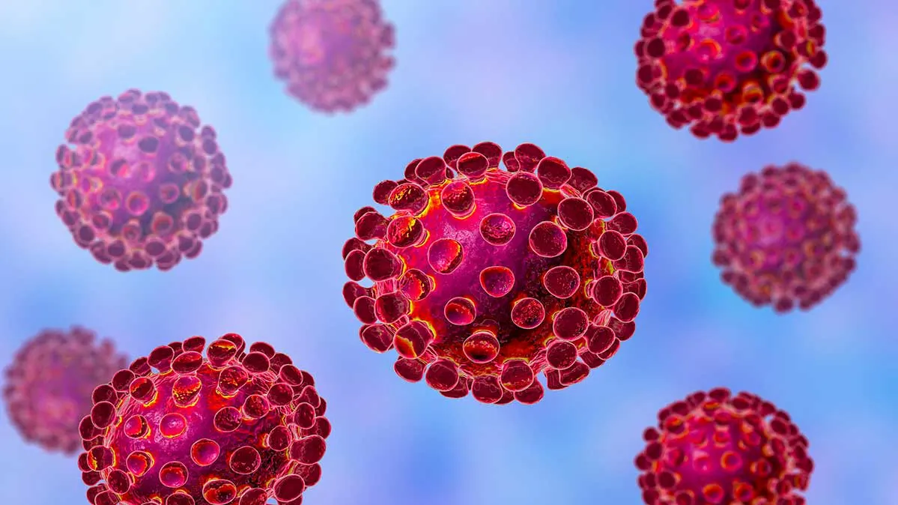
THANK YOU

